Slide 1

Intelligent Book Gifting: Elf Chatbot
Revolutionizing the gifting experience through tailored book recommendations.
Team: Armando Zamora, Casandra Murray, Gazala Siddiqi, Jessica McCarty, Philip Klimkewicz
GS

Slide 2

Trends in the Gifting Industry
Global Market Growth
Personalized Gifts Sector
The global gifting market is projected to grow from $465 billion in 2024 to $720 billion by 2032, with a CAGR of 5.6%.
Expected to reach $47.6 billion by 2030, up from $25.8 billion in 2020, driven by demand for unique offerings.
U.S. Market Projections
Books as Gifts
Valued at $62 billion in 2019, with an expected annual growth of 2%.
54% of survey respondents plan to gift books during the holiday season, highlighting their enduring appeal.

Slide 3

Challenges in Personalized Book Gifting
Deep Knowledge Required
Risk of Generic Choices
Without personalized solutions, gift-givers often resort to popular or bestselling titles, which may not resonate with the recipient's unique tastes. This can lead to disappointing gifting experiences and unused books.
Selecting the perfect book gift demands a thorough understanding of the recipient's preferences, interests, and reading history. This level of insight is often challenging to obtain or accurately assess.

Slide 4

"No two persons ever read the same book."
~ Edmund Wilson

Slide 5

Evolution of Our Chatbot Project
1
Initial Idea: Retail Christmas Shopping Chatbot
Our project began with the goal of creating a chatbot to assist users in selecting gifts for Christmas shopping. This broad approach aimed to cover various retail categories.
2
Challenge: API Restrictions
During development, we encountered significant API restrictions that limited our ability to access diverse product information across multiple retail categories.
3
Pivot to Book Gift-Giving Chatbot
Recognizing the challenges and the unique opportunity in the book market, we refocused our efforts on creating a specialized chatbot for personalized book recommendations.

Slide 6




Executive Summary
Objective
Purpose
Goals
To create an AI-powered chatbot that simplifies book gifting by providing personalized recommendations.
Enhance the emotional and personal value of book gifting by aligning recommendations with the recipient's personality, interests, and preferences.
Address the challenges of identifying the "perfect" book gift. Use advanced machine learning to guide users through a seamless gifting process. Provide a scalable, user-friendly solution for personal and corporate gifting needs.
Personalized Recommendations
Emotional Value
Seamless Gifting Process
Scalable Solution
Aligned with recipient's preferences
Personal and corporate needs
AI-powered chatbot
Advanced machine learning

Slide 7





Technology/Data Behind the Solution
Google Gemini LLM
OpenLibrary API
Advanced language model for understanding and processing user inputs with high accuracy and context awareness.
Provides access to a comprehensive book database, offering extensive metadata on titles, authors, and genres for robust recommendations.
Gradio Interface
VADER Sentiment Analysis
Ensures an intuitive and user-friendly interface for seamless interaction with the chatbot, enhancing user experience.
Analyzes user inputs for sentiment, enabling more nuanced and emotionally attuned book suggestions.

Slide 8
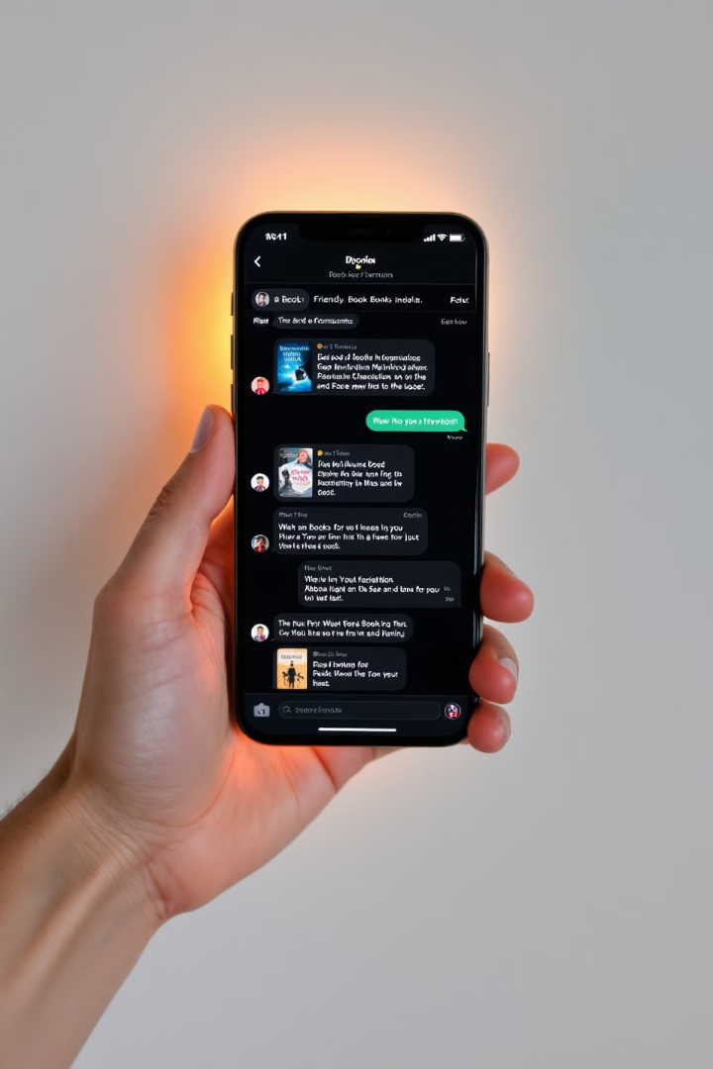
How the Chatbot Works
1
Input Stage
Users provide detailed information about the gift recipient, including personality traits, interests, and the occasion for the gift. This data forms the foundation for personalized recommendations.
2
Processing Stage
The chatbot employs natural language processing and sentiment analysis to interpret user inputs. It cross-references this information with its extensive book database to identify suitable matches.
3
Output Stage
A curated list of book recommendations is presented, complete with titles, authors, and concise summaries. This allows users to make informed decisions based on the chatbot's personalized suggestions.

Slide 9

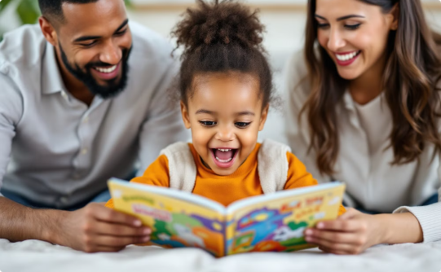

What Makes This Solution Unique?
Personalized Interaction
Advanced AI Integration
Our chatbot tailors recommendations based on detailed user inputs about the recipient, ensuring each suggestion is uniquely matched to individual preferences and interests.
Utilizing Google Gemini LLM, our solution offers superior natural language understanding and generation, providing more accurate and context-aware responses.
Extensive Database Access
Seamless User Experience
Integration with OpenLibrary API provides access to a vast collection of books, enabling diverse and comprehensive recommendations across genres and interests.
The Gradio interface ensures an intuitive and user-friendly interaction, making the book selection process enjoyable and effortless for users of all technical abilities.

Slide 10
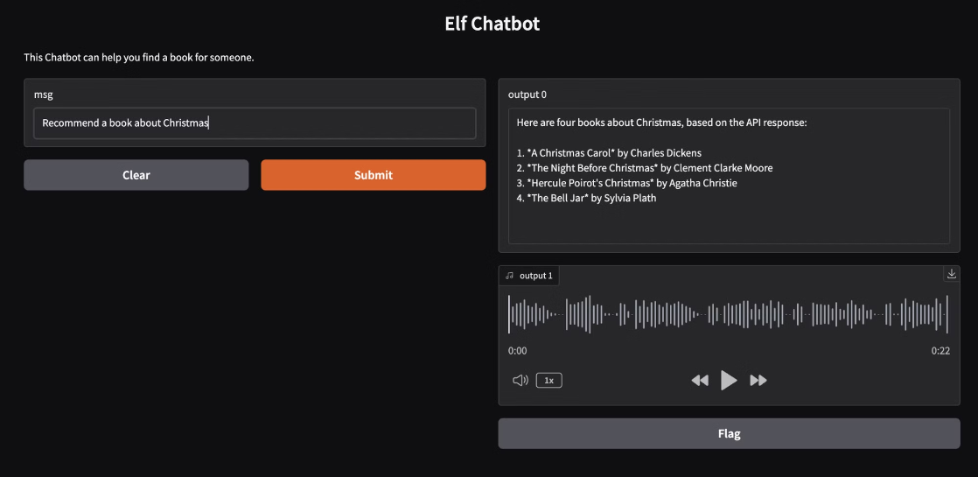
Chatbot Interface Demonstration
Our Elf Chatbot features a clean, intuitive interface designed for ease of use. The image showcases the main chat window where users interact with the AI, inputting details about the gift recipient and receiving personalized book recommendations.
Key features visible in the interface include:
A clear input field for user queries
Visually appealing book recommendation presentations
Options for refining or expanding search results
This user-friendly design ensures that even those unfamiliar with AI chatbots can easily navigate and benefit from our book gifting solution.

Slide 11

Live Demonstration
Sample Queries
Chatbot Responses
"A motivational book for my best friend who just started a new job."
For each query, the chatbot provides a curated list of book recommendations, tailored to the specific request. It considers factors like the recipient's interests, the occasion, and genre preferences to offer personalized suggestions.
"A historical fiction novel for my grandmother's birthday."
"Can you show me more options in the fantasy genre?"
The chatbot also demonstrates its ability to refine and expand results based on follow-up queries, showcasing its flexibility and depth of knowledge.

Slide 12
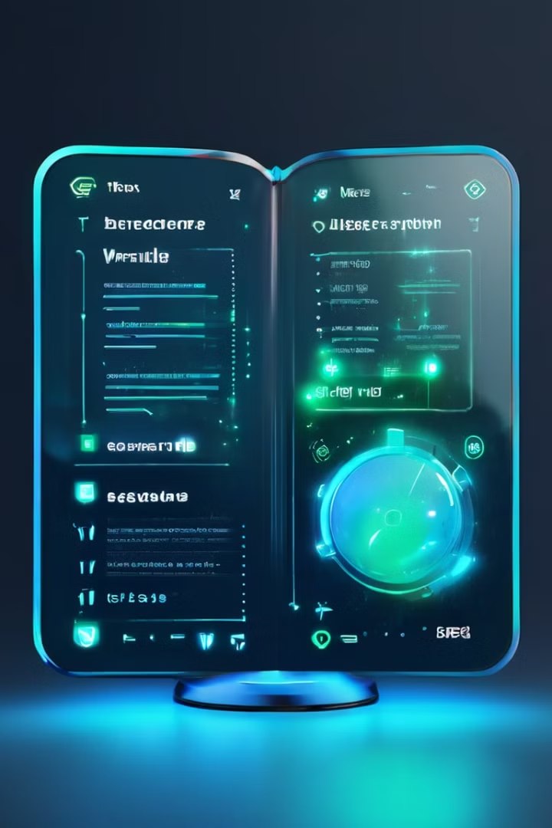
Expanding the Chatbot's Capabilities
Feature Enhancements
Business Opportunities
Add filters for genres, age groups, and publication years.
Integrate with e-commerce platforms for seamless book purchases.
Enable voice input for easier interaction.
Offer corporate solutions for employee gifting.
Expand to support multiple languages for global use.
Partner with bookstores and libraries for tailored services.

Slide 13
What We Learned
Challenges
Key Learnings
API Integration: Overcoming limitations and ensuring seamless data flow
Effective prompt design is crucial for guiding AI behavior
Prompt Engineering: Crafting effective prompts for accurate AI responses
Balancing response accuracy and processing speed improves user experience
User Feedback Integration: Balancing user input with AI recommendations
Collaboration between technical and UX teams enhances the final product
Continuous refinement based on user feedback is essential for improvement

